Slide 1

Chapter 7: Project Cost Management
Information Technology Project Management, Eighth Edition

Slide 2
Controlling Costs
Project cost control includes
Monitoring cost performance
Ensuring that only appropriate project changes are included in a revised cost baseline
Informing project stakeholders of authorized changes to the project that will affect costs
Many organizations around the globe have problems with cost control

Slide 3
Earned Value Management (EVM)
EVM is a project performance measurement technique that integrates scope, time, and cost data
Given a baseline (original plan plus approved changes), you can determine how well the project is meeting its goals
You must enter actual information periodically to use EVM
More and more organizations around the world are using EVM to help control project costs

Slide 4
Earned Value Management Terms
The planned value (PV), formerly called the budgeted cost of work scheduled (BCWS), also called the budget, is that portion of the approved total cost estimate planned to be spent on an activity during a given period
Actual cost (AC), formerly called actual cost of work performed (ACWP), is the total of direct and indirect costs incurred in accomplishing work on an activity during a given period
The earned value (EV), formerly called the budgeted cost of work performed (BCWP), is an estimate of the value of the physical work actually completed
EV is based on the original planned costs for the project or activity and the rate at which the team is completing work on the project or activity to date

Slide 5
Rate of Performance
Rate of performance (RP) is the ratio of actual work completed to the percentage of work planned to have been completed at any given time during the life of the project or activity
Brenda Taylor, Senior Project Manager in South Africa, suggests this term and approach for estimating earned value
For example, suppose the server installation was halfway completed by the end of week 1. The rate of performance would be 50% because by the end of week 1, the planned schedule reflects that the task should be 100 percent complete and only 50 percent of that work has been completed

Slide 6
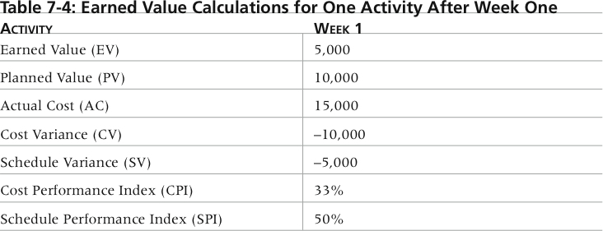
Table 7-3. Earned Value Calculations for One Activity After Week One

Slide 7
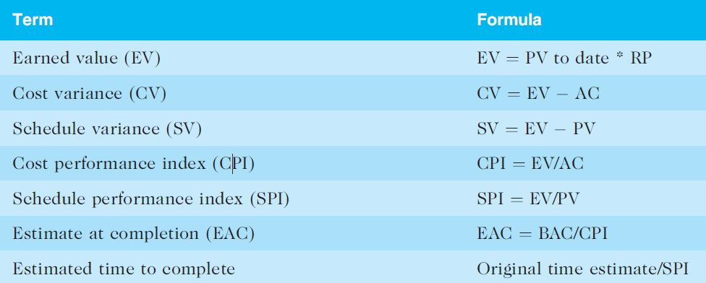
Table 7-4. Earned Value Formulas

Slide 8
Rules of Thumb for Earned Value Numbers
Negative numbers for cost and schedule variance indicate problems in those areas
CPI and SPI less than 100% indicate problems
Problems mean the project is costing more than planned (over budget) or taking longer than planned (behind schedule)
The CPI can be used to calculate the estimate at completion (EAC)—an estimate of what it will cost to complete the project based on performance to date. The budget at completion (BAC) is the original total budget for the project

Slide 9
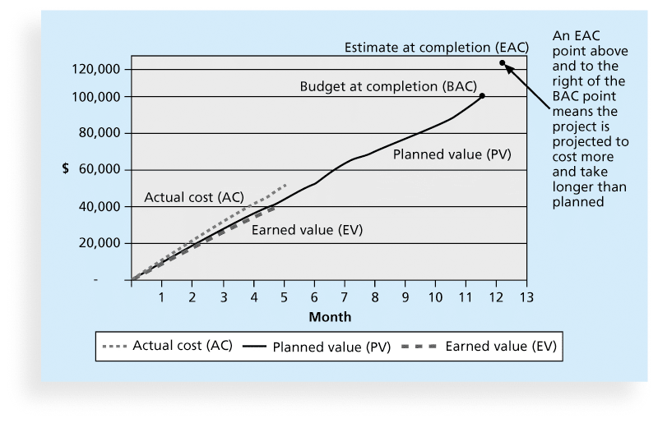
Figure 7-5. Earned Value Chart for Project after Five Months

Slide 10
Global Issues
EVM is used worldwide, and it is particularly popular in the Middle East, South Asia, Canada, and Europe
Most countries require EVM for large defense or government projects, as shown in Figure 7-6
EVM is also used in such private-industry sectors as IT, construction, energy, and manufacturing.
However, most private companies have not yet applied EVM to their projects because management does not require it, feeling it is too complex and not cost effective

Slide 11
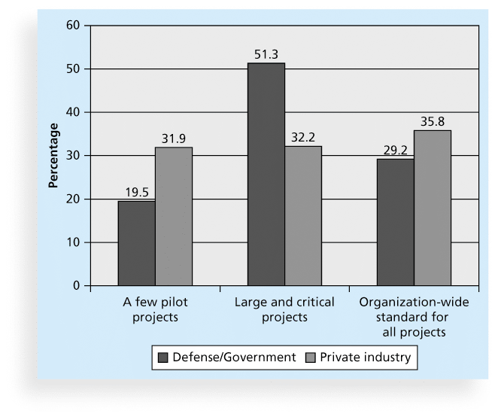
Figure 7-6. Earned Value Usage

Slide 12
Project Portfolio Management
Many organizations collect and control an entire suite of projects or investments as one set of interrelated activities in a portfolio
Five levels for project portfolio management
Put all your projects in one database
Prioritize the projects in your database
Divide your projects into two or three budgets based on type of investment
Automate the repository
Apply modern portfolio theory, including risk-return tools that map project risk on a curve

Slide 13
Benefits of Portfolio Management
Schlumberger saved $3 million in one year by organizing 120 information technology projects into a portfolio
Reduced redundant projects and coordinated those with overlap
IT projects can be huge investments, so it makes sense to view them as portfolios and track their progress as a whole

Slide 14
Using Software to Assist in Cost Management
Spreadsheets are a common tool for resource planning, cost estimating, cost budgeting, and cost control
Many companies use more sophisticated and centralized financial applications software for cost information
Project management software has many cost-related features, especially enterprise PM software
Portfolio management software can help reduce costs

Slide 15
Recent Studies on PPM Software
2014 Gartner report says the market continues to grow, with annual sales over $1.65 billion in 2014 report. The pace of change is driving the demand for enterprise software to help manage projects
Forrester estimates ROIs of 250 percent from PPM tools
Pfizer and Ford use PPM software to improve transparency of the many projects they manage

Slide 16
Chapter Summary
Project cost management is a traditionally weak area of IT projects, and project managers must work to improve their ability to deliver projects within approved budgets
Main processes include
Plan cost management
Estimate costs
Determine the budget
Control costs

